Slide 1
GAMT: A Fast and Scalable IP Lookup Engine for
GPU-based Software Routers
Author: Yanbiao Li, Dafang Zhang, Alex X. Liu and Jintao Zheng
Publisher: ANCS '13 Proceedings of the ninth ACM/IEEE symposium on Architectures for networking and communications systems
Presenter: Tung-yin Chi
Date: 2015/10/14
Notes:
ANCS : Architectures for Networking and Communications Systems

Slide 2
Introduction
The GPU is becoming an emerging platform for high performance general-purpose computing.
J. Zhao et al. [27] - GPU-Accelerated Lookup Engine (GALE)
  only applicable for IPv4
  decline sharply with the increase of update frequency
GPU-Accelerated Multi-bit Trie (GAMT)
  Scale to IPv6 smoothly
  Keep stable lookup throughput under highly frequent updates
  Improve lookup performance with latency controlled

Slide 3
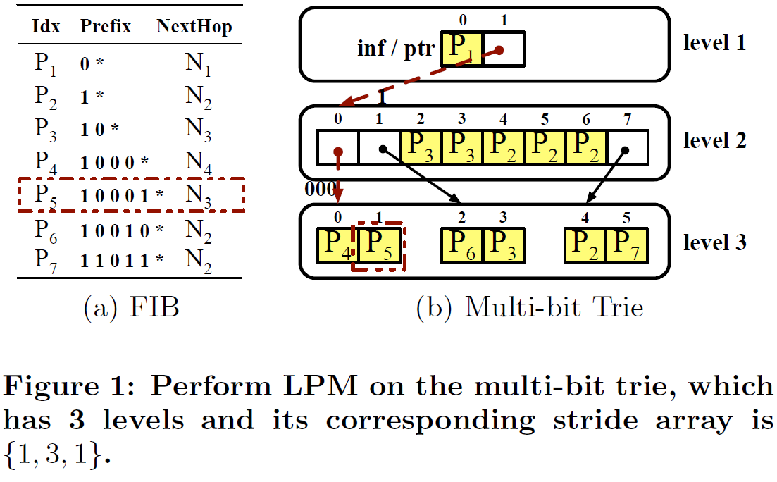
Background and Related Work
Multi-bit Trie

Slide 4
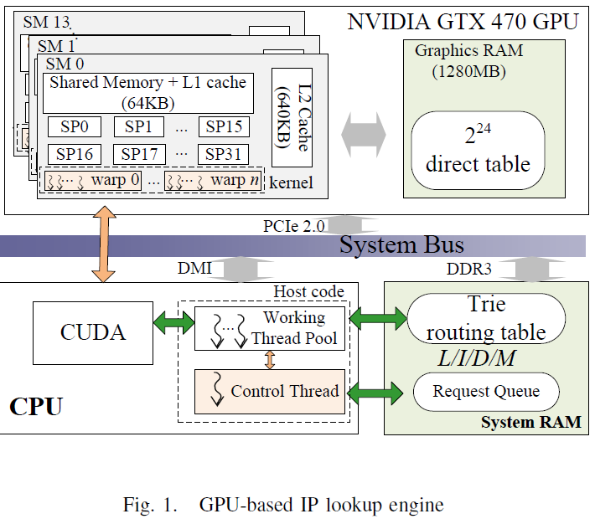
Background and Related Work
CUDA Programming Model
  Coalescence of Global Memory Accesses
  Overlapping Behaviors on the GPU
GPU-Accelerated IP Lookup Engine

Slide 5
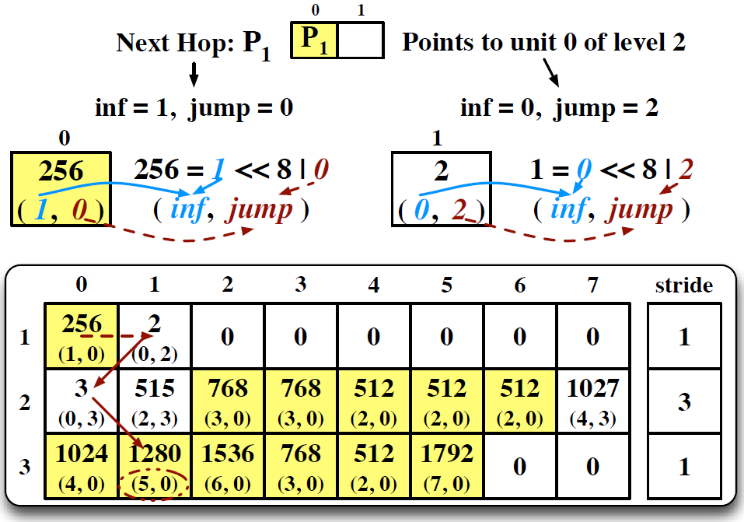
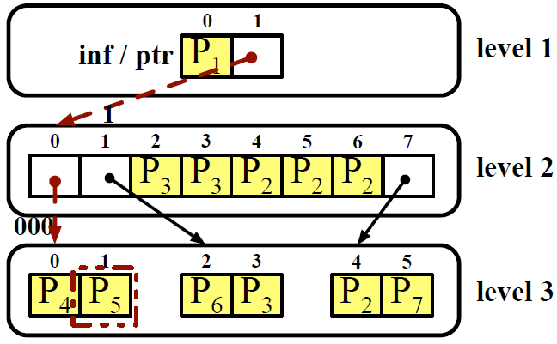
GPU-accelerated Multi-bit Trie
Encoding Rules and Lookup Approach

Slide 6
GPU-accelerated Multi-bit Trie
Encoding Rules and Lookup Approach
  Ex : 10001*
    Step 1. Default (inf, jump) = (0, 1)
    Step 2. (inf, jump) = (0 + 1, 1) = (1, 1) => (inf, jump) = (0, 2)
    Step 3. (inf, jump) = (0 + 0, 2) = (0, 2) => (inf, jump) = (0, 3)
    Step 4. (inf, jump) = (0 + 1, 3) = (1, 3) => (inf, jump) = (5, 0)

Slide 7
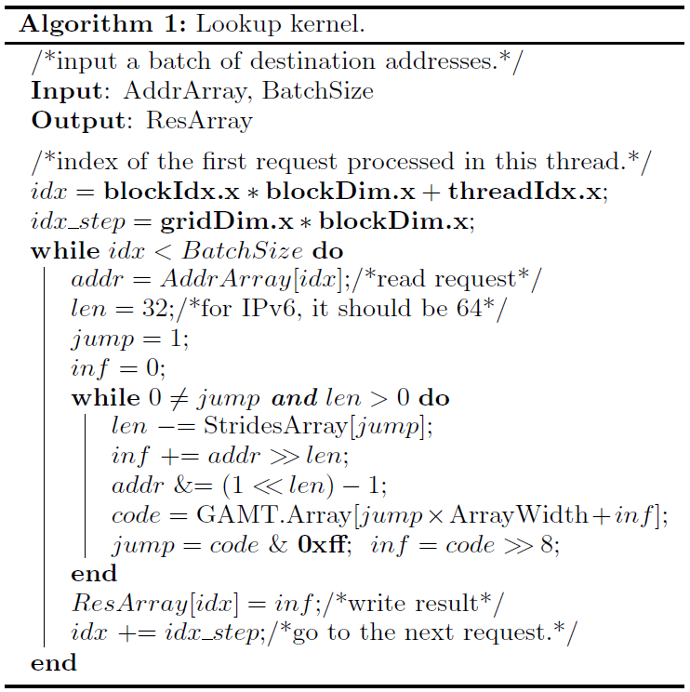
GPU-accelerated Multi-bit Trie
Encoding Rules and Lookup Approach

Slide 8
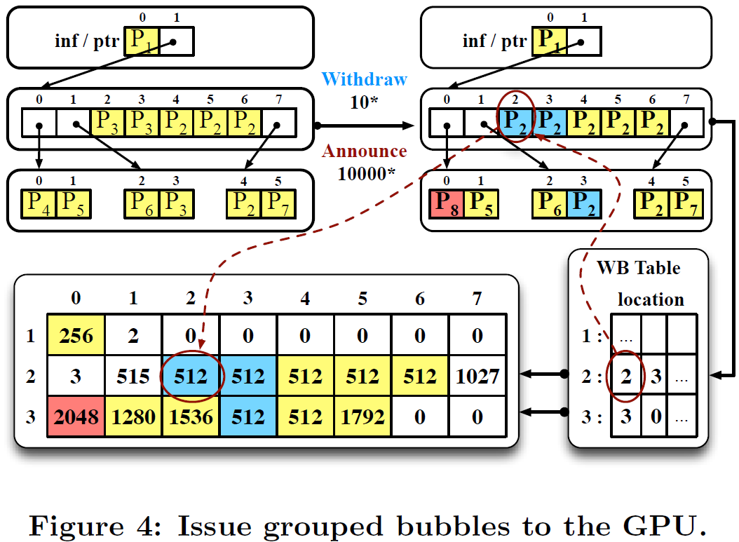
GPU-accelerated Multi-bit Trie
Update Mechanism

Slide 9
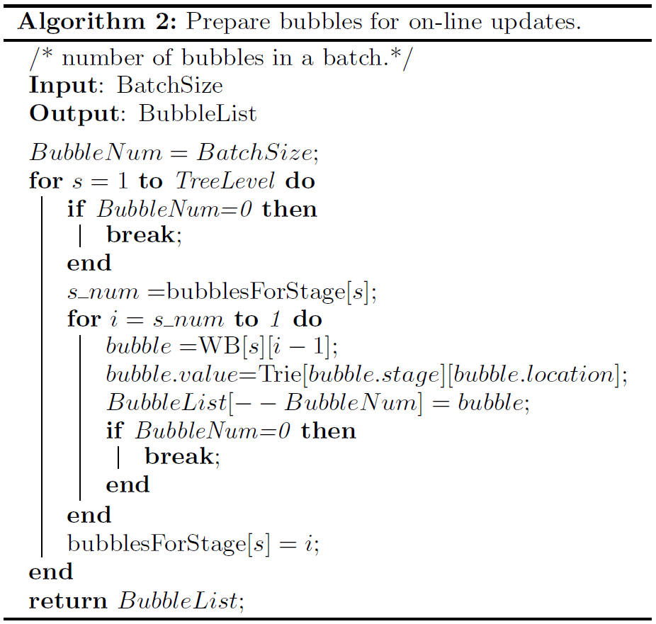
GPU-accelerated Multi-bit Trie
Update Mechanism

Slide 10
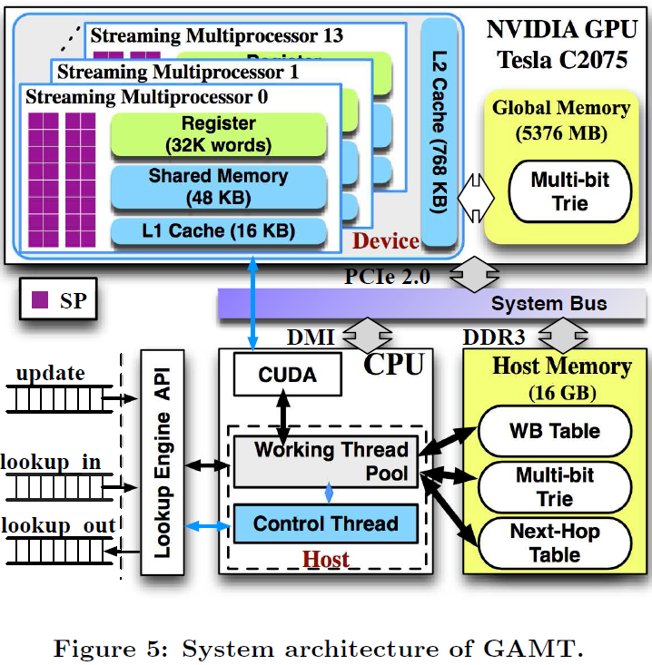
GPU-accelerated Multi-bit Trie
Architecture Overview

Slide 11
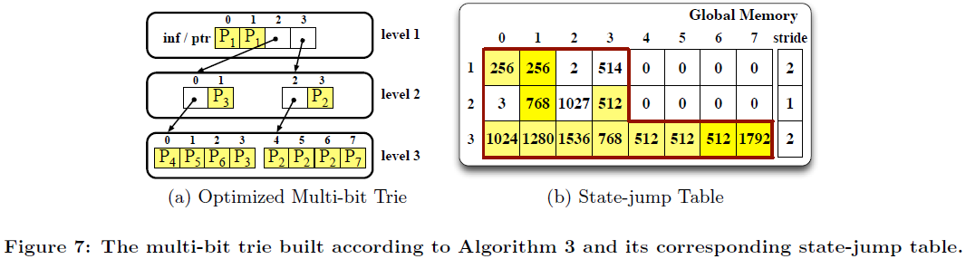
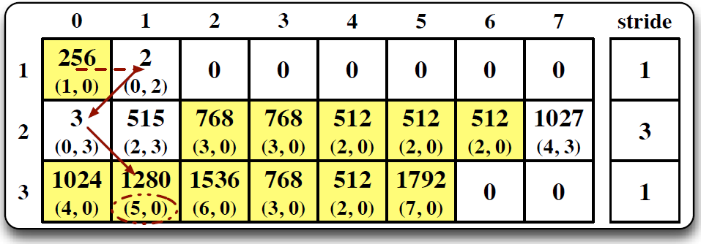
Performance Optimization
Optimized Multi-bit Trie

Slide 12
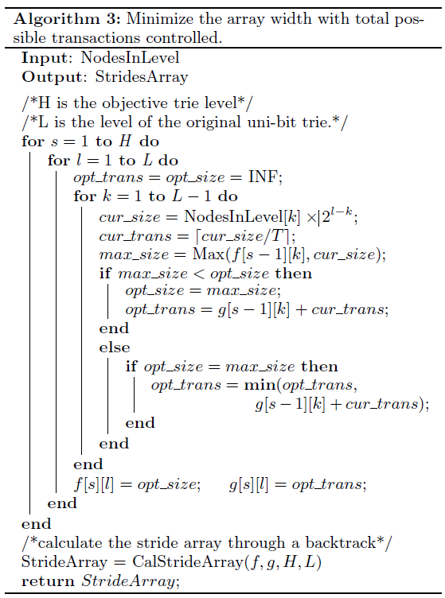
Performance Optimization
Optimized Multi-bit Trie

Slide 13
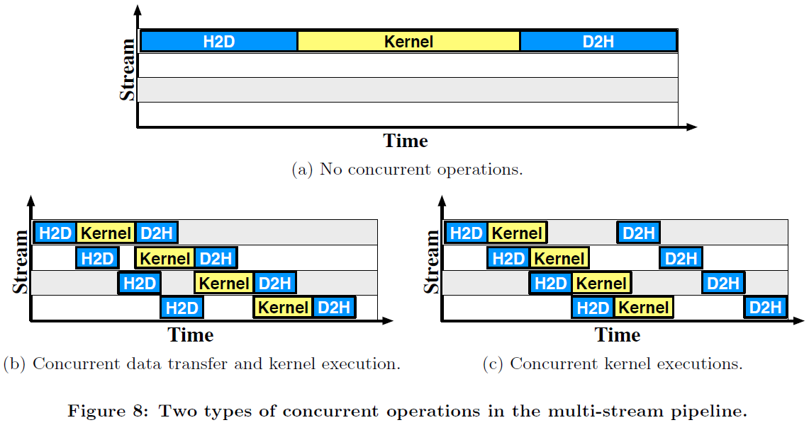
Performance Optimization
Delete in Lazy Mode
Multi-Stream Pipeline

Slide 14
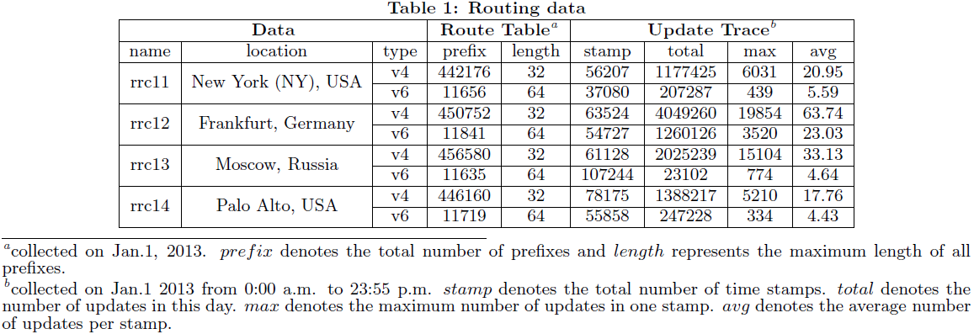
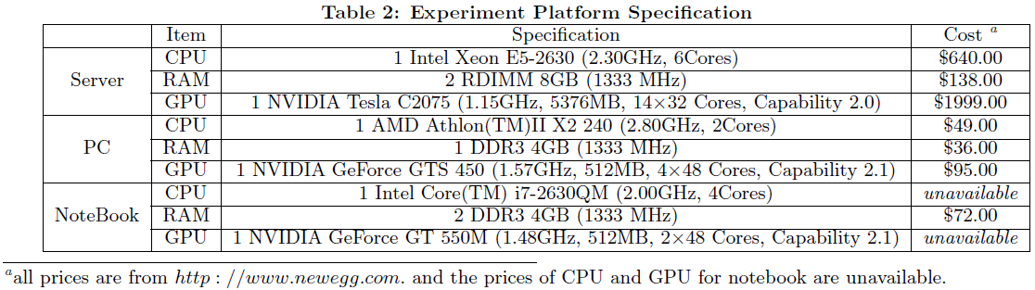
Experimental Evaluation
Evaluation Methodology

Slide 15
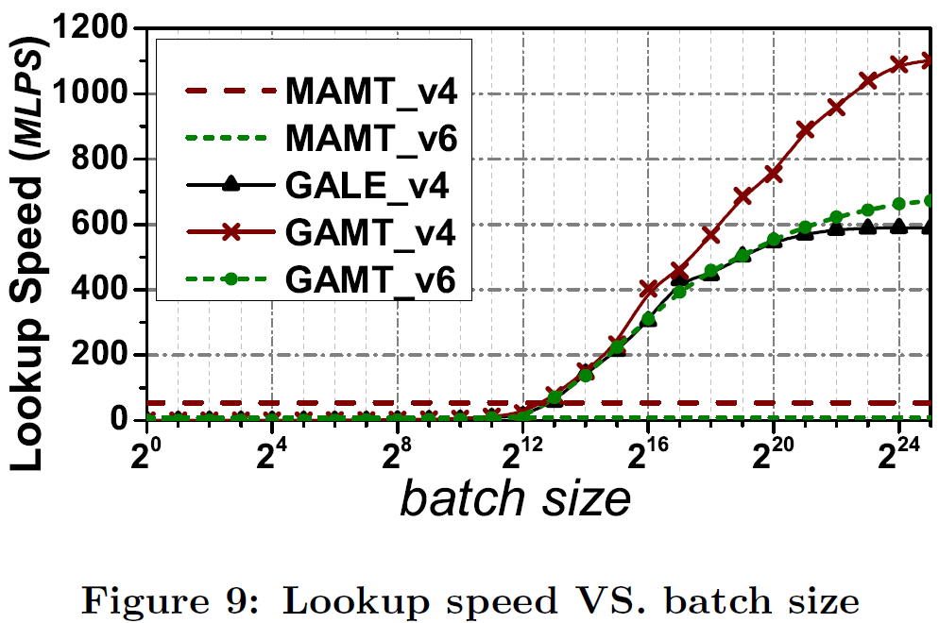
Experimental Evaluation
Evaluation Methodology

Slide 16
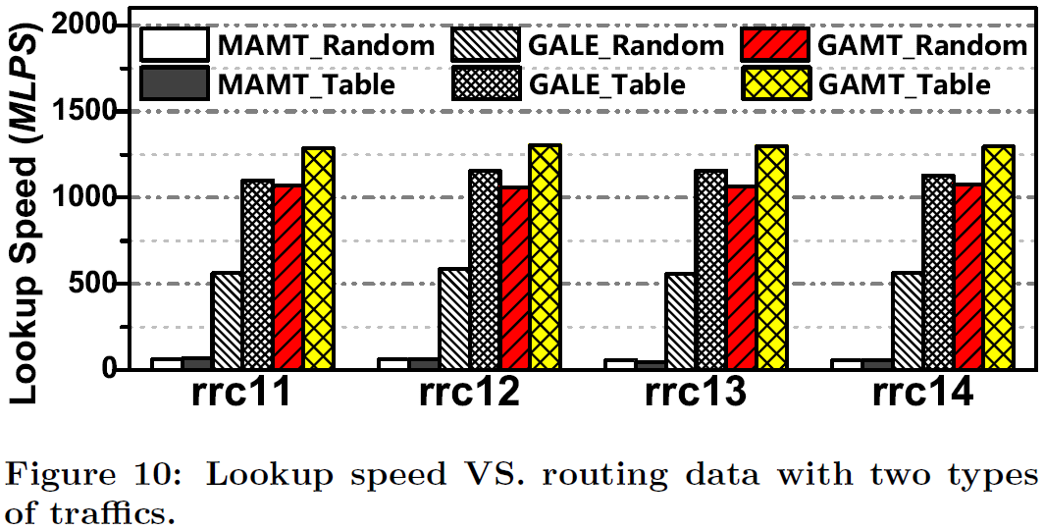
Experimental Evaluation
Lookup Performance

Slide 17
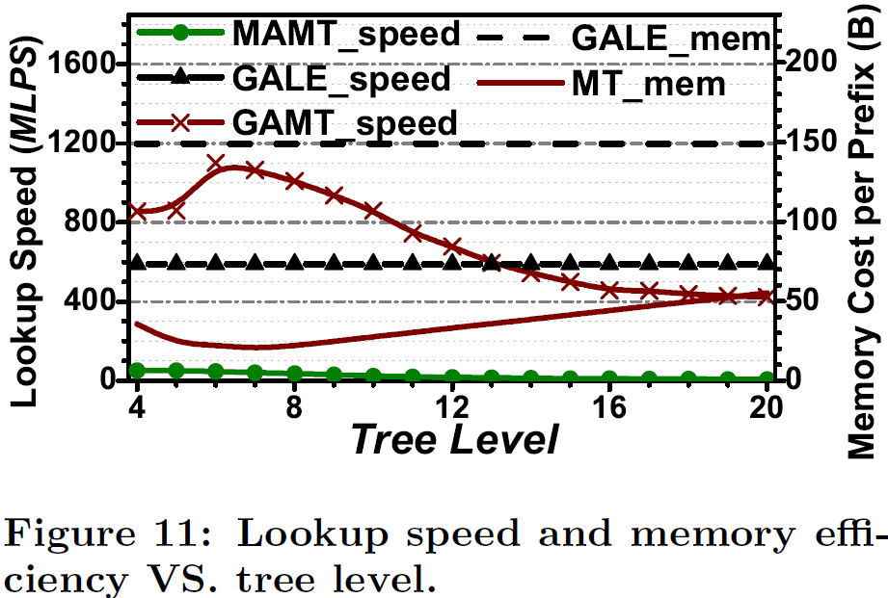
Experimental Evaluation
Lookup Performance

Slide 18
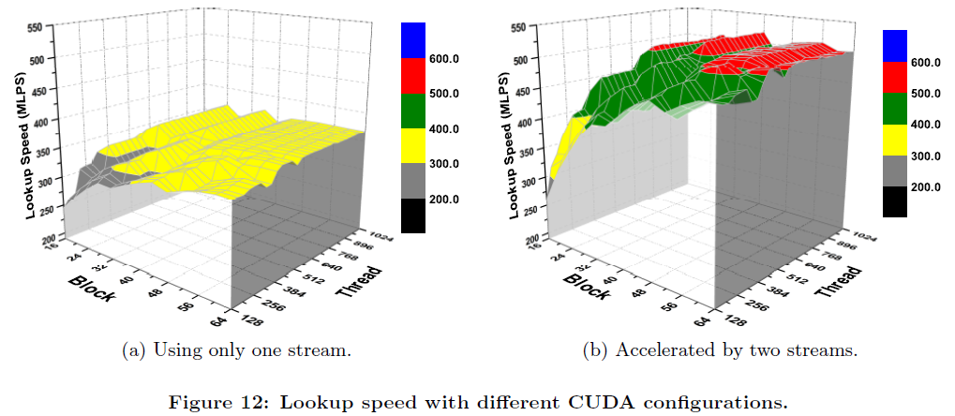
Experimental Evaluation
Lookup Performance

Slide 19
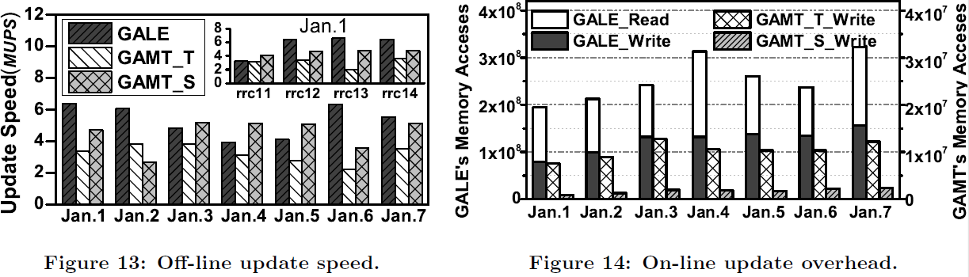
Experimental Evaluation
Update Overhead

Slide 20
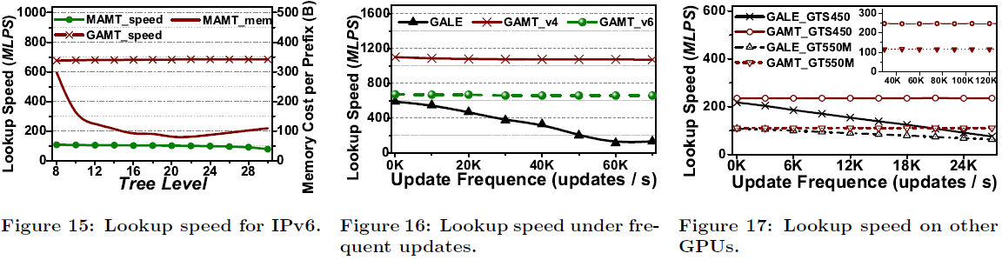
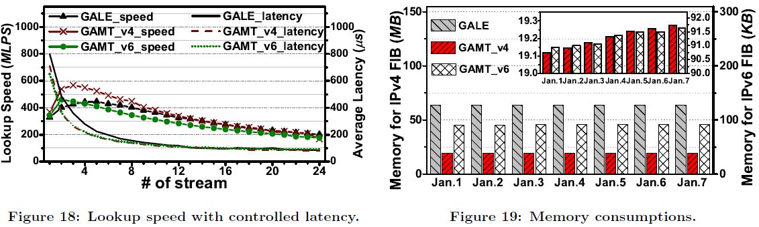
Experimental Evaluation
Comprehensive Performance

